Slide 1
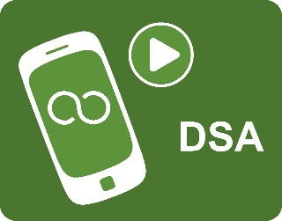
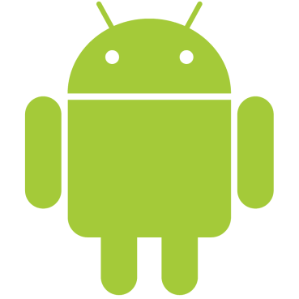
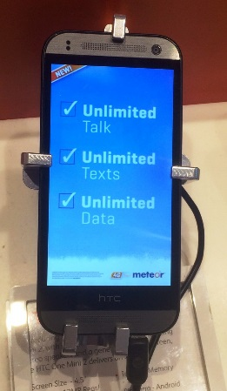
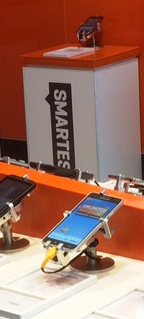
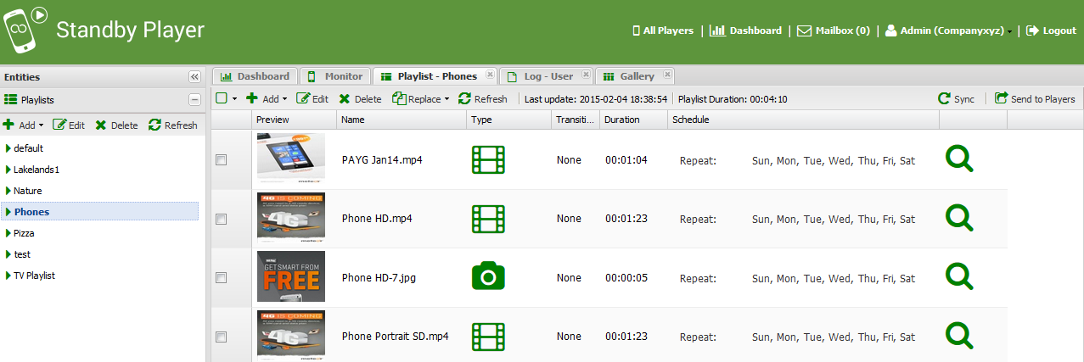
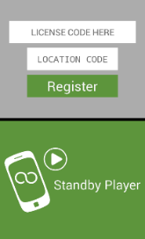
DSA Standby Player App
Digital Signage for Android Phones and Tablets
DSA is a digital signage solution for Android devices. DSA comprises a platform independent Content Management Service (CMS) hosted in the Cloud and a Player App.
DSA Standby Player is a specialized Android application designed for Android phones and tablets. DSA Standby Player allows centrally controlled content to play on in-store demonstration devices while they are not in use. By touching the screen, customers can access the device and experience normal device functions. A short time after this interaction ceases the Standby Player automatically resumes its programmed content.
Download App from dsa-cloud.com
Install App on devices
Register devices with DSA Service
Default playlist downloads and starts
Access DSA Service from any browser
Upload your pictures and/or videos
Create playlists and target at devices
Manage 100’s or 1000’s of devices
Leverage in-store screens
Promote product messages
Video or static images
Create a nationwide channel
Cost effective asset use
Allow customer access for demo
Device reverts to messages
Lock out device settings
Management of a large estate of standby players is easy using the DSA Cloud Service. Phones & Tablets, with the Standby Player App installed, connect using WIFI (or 3G/4G) to the Cloud. Once registered to the DSA Cloud Service, players can be centrally monitored and controlled using an intuitive user interface. Users can access the DSA Cloud Service from anywhere using any PC, MAC or Tablet browser.
Easy to build playlists, set durations, re-order, set transitions, timing, conditional play

Slide 2
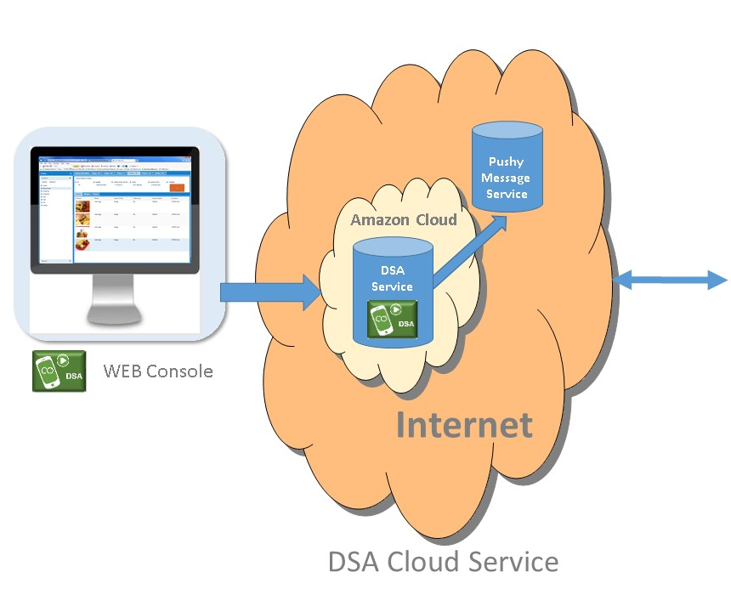
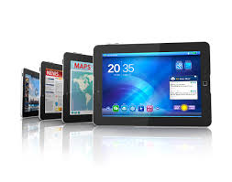
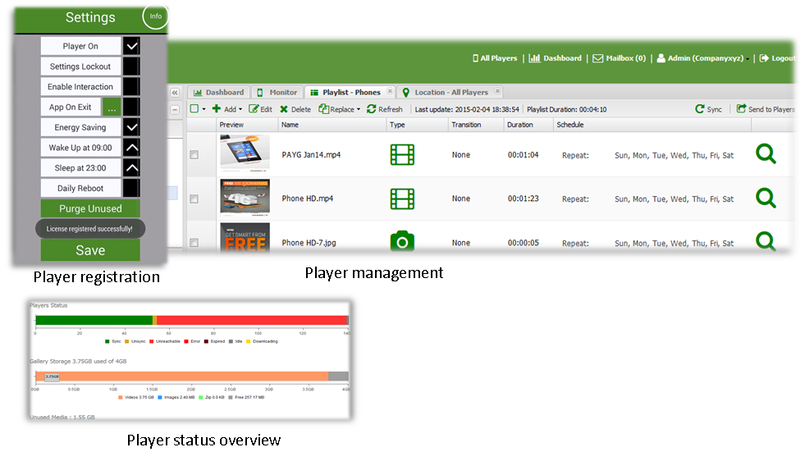
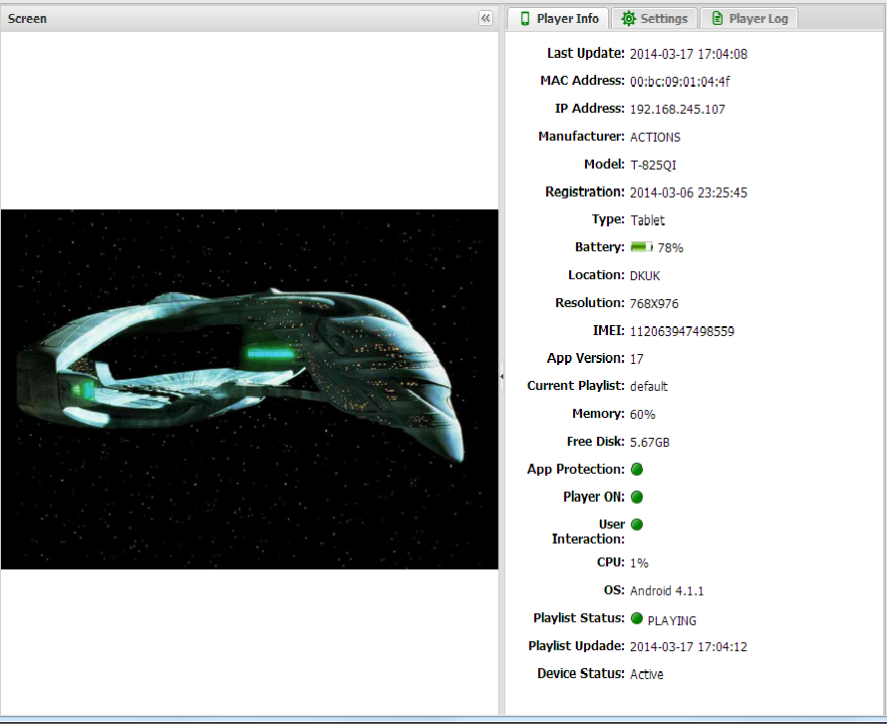
Retail Tablets
Store Router
Retail Mobiles
In Store Devices
Detailed player metrics available
including real time snapshot
The DSA Standby Player App is provided and supported by:
DSA Standby Player V1.1

